Slide 1
BIZ06 – Bahasa Inggris 2

Slide 2
When things go wrong
Meeting 12

Slide 3
Specific Competence
Students are able to use the language to make complaints and deal with them.
Students are able to use the rules of second conditional, and adverbs that modify adjectives in business contexts

Slide 4
1. Second Conditional

Slide 5
1.1 Form
Second conditional sentences describe “unreal” situations – things that can’t or probably won’t happen.
We use:
Example:
If the customer complained, we would apologize.
would + a verb in the main clause and past tense in the if-clause.
IF-CLAUSE (PAST TENSE)
MAIN CLAUSE (WOULD)

Slide 6
1.1 Form
Sometimes we use were instead of was.
Example:
If I were you, I would solve the problem right away.
Note:
Normally, “I” would be paired with was. But, in second conditional if – we expresses something that is impossible. So, the subject : I, He, She, It are paired with were.

Slide 7
1.2 Use
Note:
Use comma when the if conditional is writen in the begining.
DO NOT USE comma when the if conditional is writen in the end of the sentence.
If it wasn’t so urgent, I would not call you USE COMMA!
I would not call you if it was not so urgent NO COMMA!

Slide 8
Practice 1
Open page 64 to answer the questions in part A, B and C.

Slide 9
2. Adverbs modifying adjective

Slide 10
2.1 Use
RULE:
Example:
He gives me some really beautiful flowers.
It’s extremely urgent.
Adverbs that modify adjective come before the adjective.
adverb
adj
adverb
adj

Slide 11
Practice 2
Open page 65 to answer questions in part F and G.

Slide 12
3. Vocabulary

Slide 13
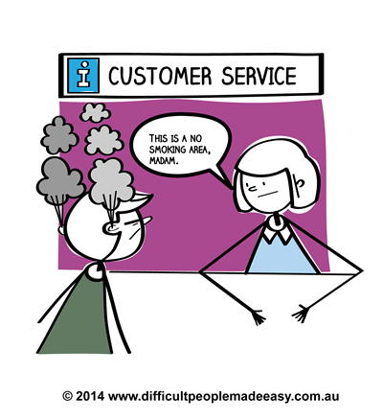
3.1 Vocabulary: complaints
Vocabulary focus: Complaints and apologies
COMPLAINTS | DEALING WITH COMPLAINTS
I’m sorry to say this, but... | Sorry for the inconvenience.
I’m sorry to bother you, but.. | It won’t happen again.
I’m afraid there’s a problem. | Please accept our appologies.
I expect an apology. | I’m afraind it was our mistake.
Excuse me if I’m out of line, but... | We’re really very sorry.
It seems that you forgot to... | I’ll look into it immediately.
Polite way to complaint.
Polite way to respond back.

Slide 14
3.1 Vocabulary: complaints
PREPOSITION
I’m afraid I have a complaint about the delivery.
I’ll look into the complaint immediately.
The delivery arrived on time.
I’ll wait for your call.
The manager apologized for the mistake.
We’ll send the order by express delivery.
I want to know the reason for the mistakes.
Note:
The underlined words are the correct pair.

Slide 15
3.2 Vocabulary:
easily confused words
accept or except?
Example:
Please accept our apologies.
The office is open everyday except Mondays.
To accept is a verb. The word except means “but not”.

Slide 16
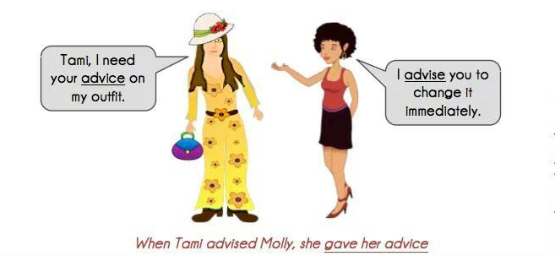
3.2 Vocabulary:
easily confused words
B) advice or advise?
To advise is a verb. The word advice is a noun.

Slide 17
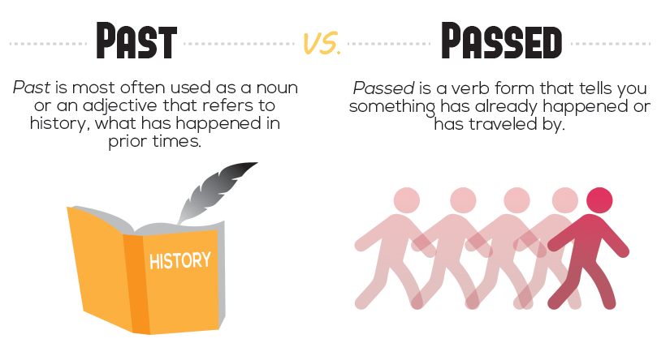
3.2 Vocabulary:
easily confused words
C) passed or past?
Passed is a regular verb. The word past is an adjective , noun or preposition.

Slide 18



3.2 Vocabulary:
easily confused words
D) fell or felt?
The past tense of the verb to fall is fell jatuh
The past tense of to feel is felt merasa
She felt cold.

Slide 19
Practice 3
Open page 68 to answer questions in part D, E, F and G.

Slide 20
3. Vocabulary

Slide 21

Practice 4
Play audio file track 36 to answer questions on page 63 part A and B.
Play audio file track 37 to answer questions on page 66 part A and B.

Slide 22
Thank You

